Slide 1

title :- Edu-Bot World : Where AI Makes Learning Fun
Presented by: V. Sai Vaishnavi-23TQ1A6639
J. Sushmitha-23TQ1A6642
J. Sai Charan -23TQ1A6654
Team No:11
GUIDE:
TSKS. JYOTHIRMAYI

Slide 2
contents
Abstract
Introduction
Existence System
Proposed System
System Architecture
Requirements
UML diagrams
Sample codes
Modules screenshots
Conclusions
Future scope
References

Slide 3
Abstract
Edu-Bot World is an innovative educational platform designed to revolutionize the learning experience for children by integrating artificial intelligence with interactive gaming. The platform features a variety of AI that act as personalized learning companions, guiding students through different subjects in an engaging and fun way.
The primary goal of Edu-Bot World is to make education a playful adventure, where learning feels more like a game than a task. By using machine learning algorithms, the bots continuously assess a child’s progress and adjust content in real-time to ensure optimal learning outcomes. Edu-Bot World promotes critical thinking, problem-solving, and creativity, offering a dynamic learning environment that enhances cognitive development.

Slide 4

Introduction
In the digital era, education is transforming. EduBot World leverages AI to enhance learning by making it more interactive and personalized. The platform caters to diverse learners, making education fun, accessible, and effective.
Each bot is tailored to adapt to the child’s learning pace and style, offering customized challenges, quizzes, and games that keep them motivated and eager to learn.

Slide 5

Existing System
Busy Things: provides a collection of educational apps covering various subjects including maths , science through games and puzzles.
Lingo Kids : A play learning app focusing on enjoyable and learning experience that promote critical thinking.
Turtle Diary :Offers interactive educational games for children , covering topics like math language arts.

Slide 6
Proposed System
Personalized Learning Journey Adapts content and difficulty based on student performance, preferences, and pace.• Interactive, gamified learning modules.
AI-Driven Feedback and Motivation Virtual tutors and bots offer real-time feedback, encouragement, and concept clarification.• Real-time feedback and progress tracking.
Gamified Learning Experience Lessons are turned into interactive missions or challenges, boosting student engagement.

Slide 7
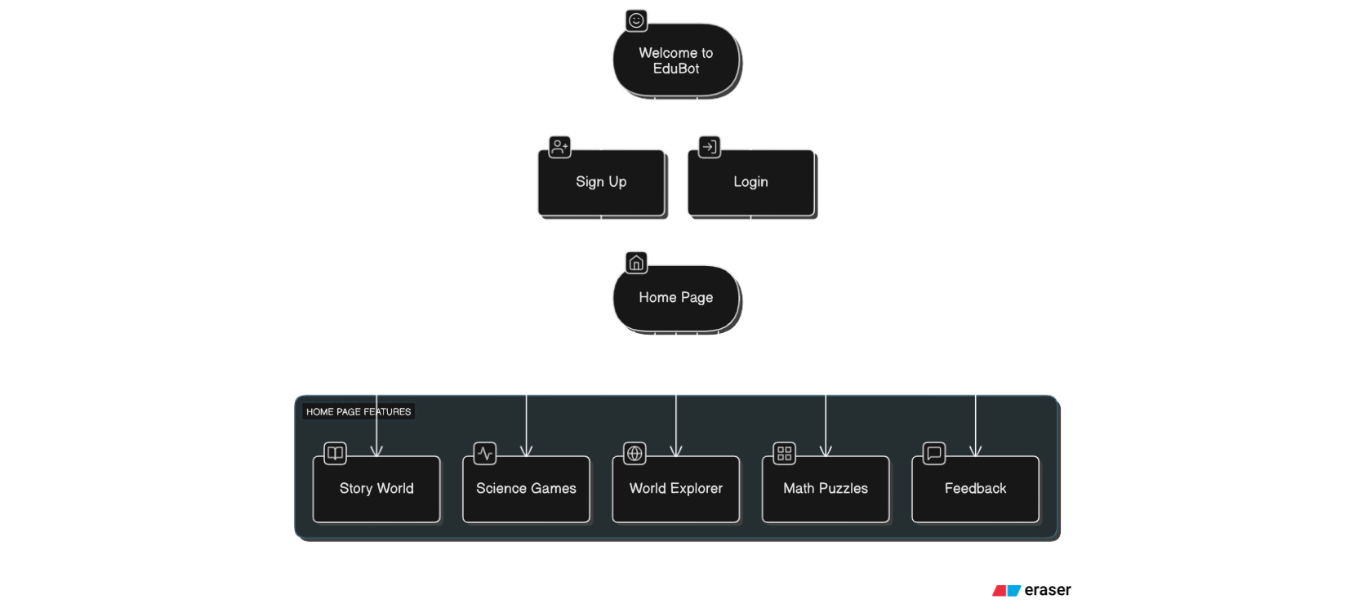
System Architecture

Slide 8
Requiremments
hardware
software
Processing unit(CPU): Intelcore i5/i7
RAM: 16GB Ram(min)
Storage: SSD 512GB
Programming languages: Frontened: HTML, CSS Backend: PYTHON, DBMS

Slide 9
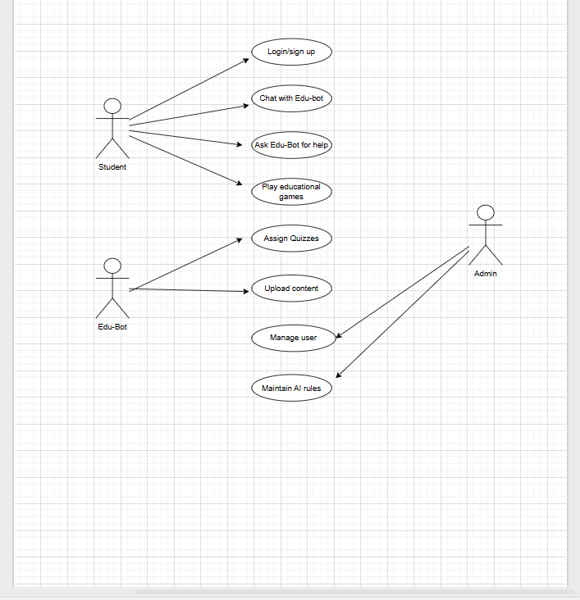
UML Diagram
USE-CASE DIAGRAM

Slide 10
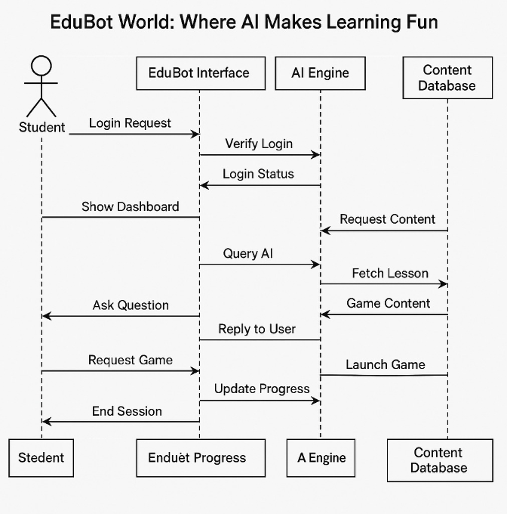
UML DIAGRAM
SEQUENCE DIAGRAM

Slide 11
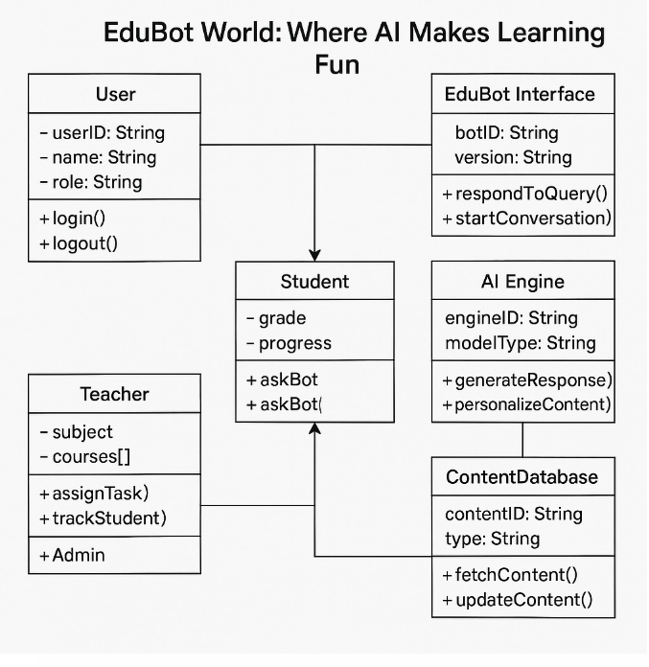
UML DIAGRAM
CLASS DIAGRAM

Slide 12
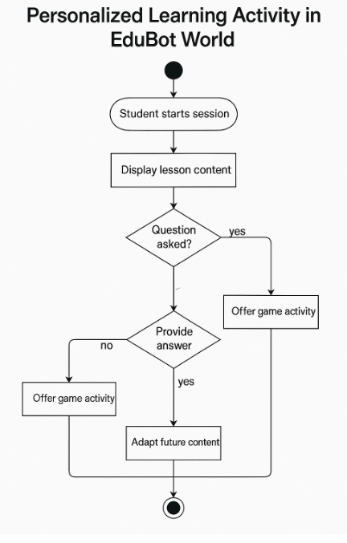
UML DIAGRAM
ACTIVITY DIAGRAM

Slide 13
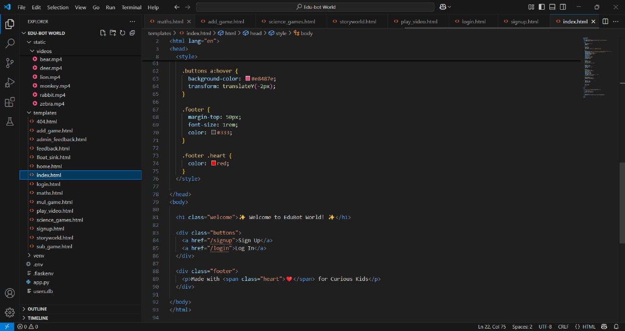
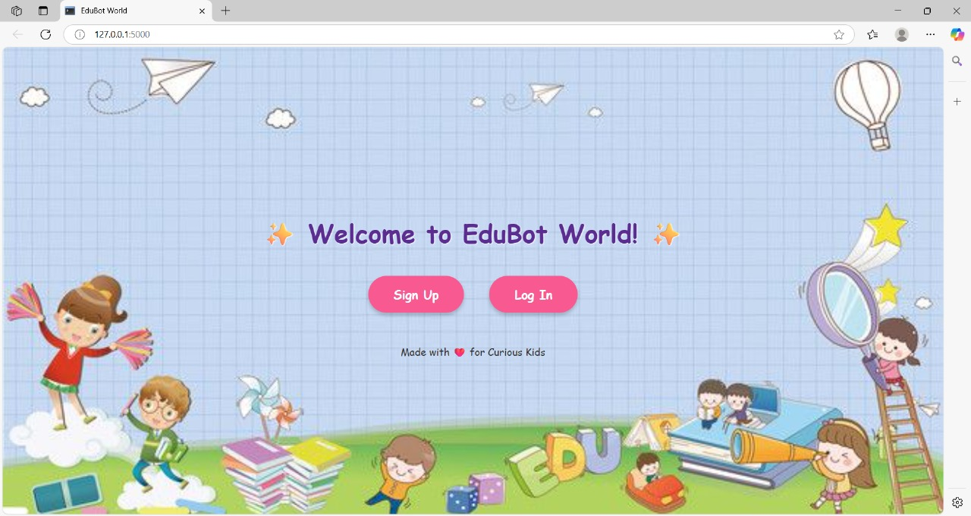
Sample code

Slide 14
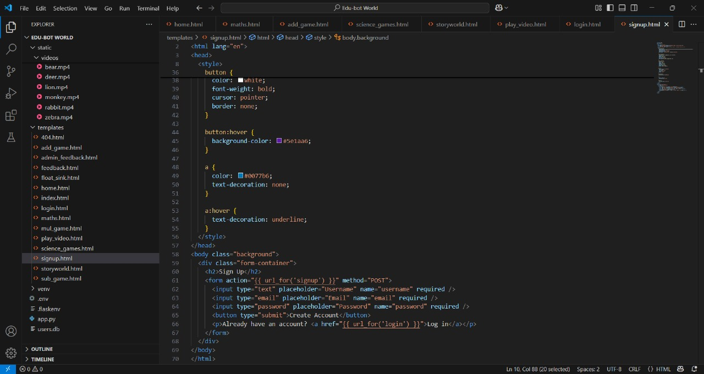
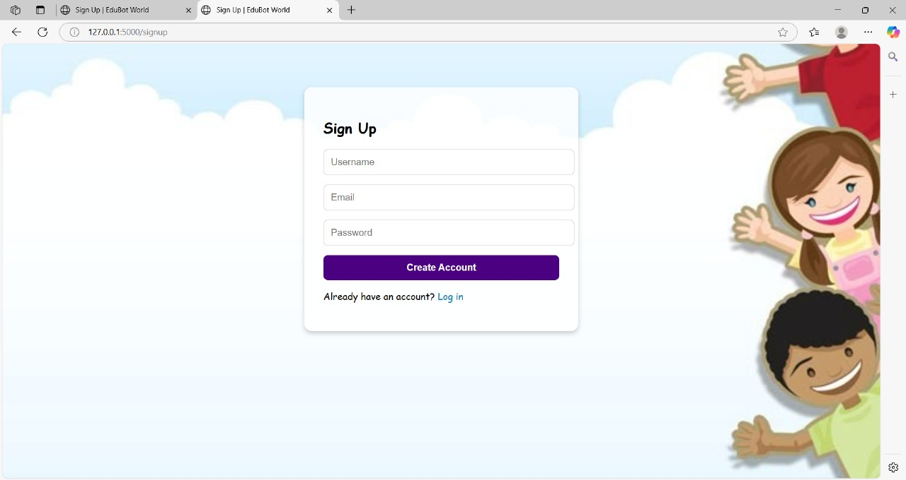
Sample code

Slide 15
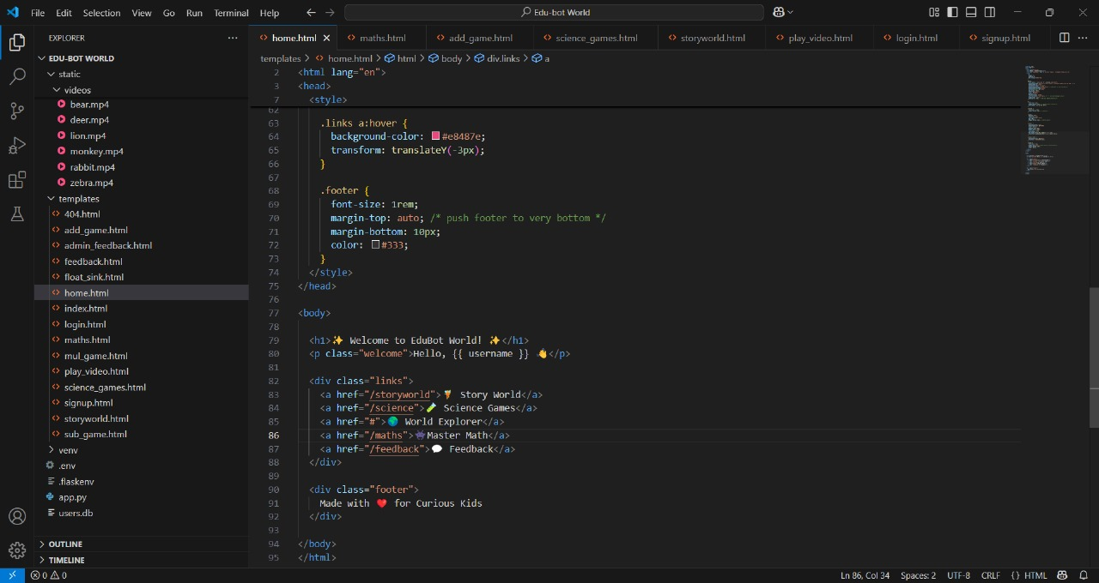
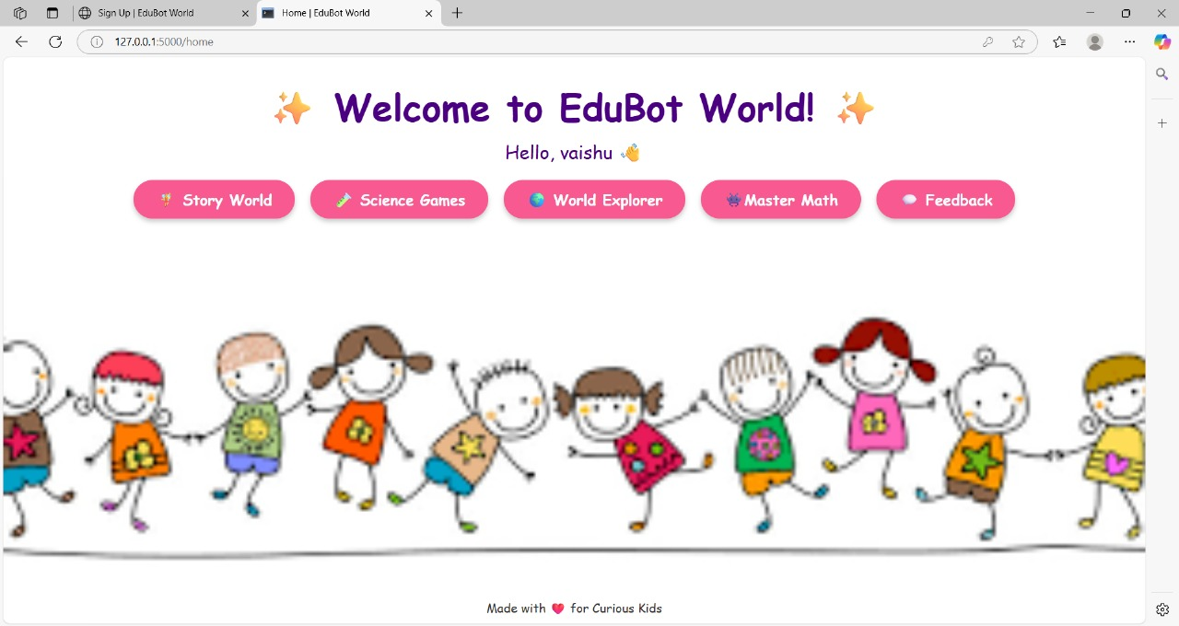
Sample code

Slide 16
Modules screenshots

Slide 17
Modules screenshots

Slide 18
Modules screenshots

Slide 19
conclusion
Edu-Bot World successfully demonstrates how AI can be leveraged to create an interactive and engaging learning platform for students. By integrating educational games, quizzes, and personalized learning content, the system promotes a fun and adaptive learning experience. The use of AI not only enhances user engagement but also assists in delivering customized learning paths based on student performance.
The project effectively addresses the gap in conventional learning methods by providing an interactive educational environment that encourages students to learn through exploration and play. Additionally, the use of robust technologies like ReactJS, Firebase, and AI libraries ensures scalability, flexibility, and real-time feedback, making Edu-Bot World a comprehensive solution for modern digital learning.
In conclusion, Edu-Bot World not only facilitates academic learning but also fosters curiosity, creativity, and critical thinking among students, paving the way for a smarter and more accessible educational future.

Slide 20
Future scope
Advanced Personalization: Implement more sophisticated AI algorithms to tailor learning content based on student performance and learning patterns.
Gamification Enhancements: Develop new educational games that cover additional subjects such as history, geography, and language skills.
Multi-Language Support: Expand content availability in multiple languages to cater to a wider range of students.
AI-Driven Analytics: Integrate AI analytics to track user progress and generate detailed learning reports.
Teacher and Parent Dashboards: Develop separate dashboards for teachers and parents to monitor student progress and assign tasks.
Content Expansion: Add new modules such as coding challenges, science simulations, and math problem-solving games.

Slide 21

references
React: https://reactjs.org/docs/
OpenAI GPT Documentation: https://platform.openai.com/docs
Chart.js : https://www.chartjs.org/
Firebase Documentation: https://firebase.google.com/doc
Chart.js : js: https://www.chartjs.org/

Slide 22

Thank You..!!

